Slide 1


Coursera Capstone
IBM Applied Data Science Capstone

Slide 2
Where to Open Fast Food Restaurant, LA
By - Kavin Shah
August 2020

Slide 3
Business Problem
A group of investors started a small Fast food restaurant chain in Alabama. One of the decisions made during last business strategy company meeting was to confirm a plan to establish and deploy new stores on the west coast via launching stores in Los Angeles. As a consequence, a first pilot project is launched, and Raymond, project leader was nominated with first objective to launch 10 new stores in Los Angeles, CA. The success of this initiative is crucial for the next phases of the project and for the development of additional stores. Among Raymond’s key tasks, he needs to work with a real estate consultant to identify available venues in Los Angeles and close relevant deals as soon as possible to deploy the stores.

Slide 4
Data
Data was acquired from Datafiniti's Business Database.
Apart from that I also took dataset for State codes; and
The population dataset of the states (both from Google)

Slide 5
Methodology
Data Cleaning to remove duplicates and Null values
Use Foursquare API to get venue data
Group data by neighborhood and taking the mean of the frequency of occurrence of each venue category
Perform clustering on the data by using k-means clustering
Select top 3 most visited venues in the neighborhood for understanding the vibe of the neighborhood.
Visualize the clusters in a map using Folium

Slide 6
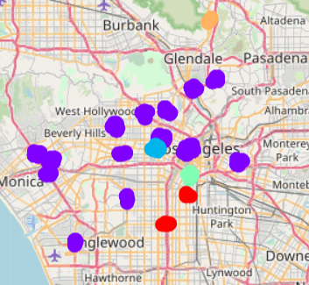
Results
Cluster 0 (red) – Good for Fast-food restaurants
Cluster 1 (Purple) – Excellent for Fast-food restaurants
Cluster 2 (sky blue) – Moderate for Fast-food restaurants
Cluster 3 (neon green) and 4 (yellow) – Not good for Fast-food restaurants

Slide 7
Discussion
Most of the Fast-food restaurants are concentrated in the central area of the city
Highest number in cluster 1 followed by cluster 0
Clusters 3 and 4 have very low number of Fast-food restaurants in the neighborhoods
Oversupply of Fast-food restaurants mostly happened in the central area of the city, with the suburb area still have very few Fast-food restaurants, but this mostly comes down to the foot-fall of LA.

Slide 8
Conclusion
Answer to business question: The neighborhoods in clusters 0 and 1 are the most preferred locations to open a new Fats-food restaurants
Findings of this project will help the relevant stakeholders to capitalize on the opportunities on high potential locations with great foot-fall while avoiding deserted areas in their decisions to open a new Fats-food restaurant.

